Slide 1

NNTC Request Rubric v2.0

Slide 2
New NNTC Request Rubric
During the transition to a contract mechanism, the NNTC has devoted significant effort to revise, streamline, and coordinate biobank-related processes and procedures.
The overarching goals of these efforts are to:
  Make NNTC specimen and data resources more available and accessible to the research community,
  Provide NNTC resources to researchers more effectively and efficiently, and
  Increase the transparency and accountability of NNTC processes and procedures
To meet these goals, the NNTC has collaboratively developed a new Rubric for the processing and fulfillment of biospecimen and data requests.
The purpose of the new NNTC Request Rubric guidelines is to make both requestors and the NNTC responsible for meeting specific expectations and timelines for application submission, processing, review, and fulfillment of specimen and data requests.

Slide 3
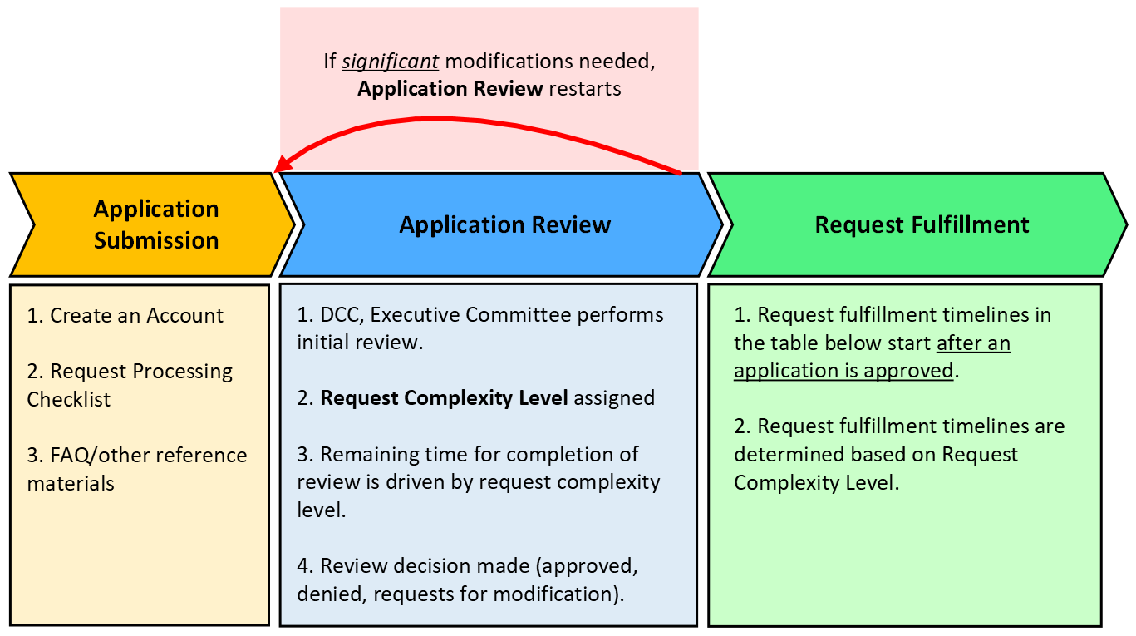
Request Process Overview
Note: Applications requiring only minor modifications may not need to return to the beginning of initial screening.

Slide 4
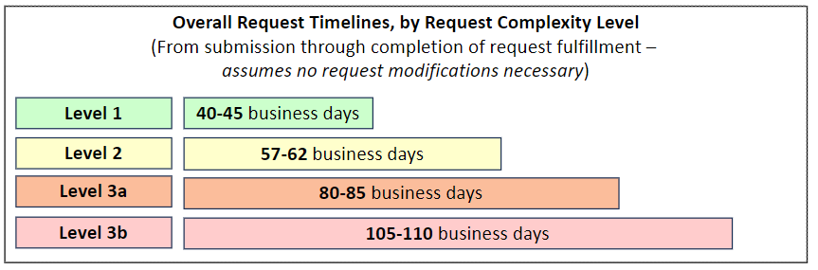
Overall Timelines, by Request Complexity Level
  Timelines are tiered based on “Request Complexity Level”
    Request Complexity Level (Levels 1, 2, 3a, 3b) – drives timelines
      Takeaways:
        Level 1 requests are reviewed and fulfilled the quickest.
        More complex Level 2, 3a, and 3b applications require longer timelines for review and fulfillment.

Slide 5
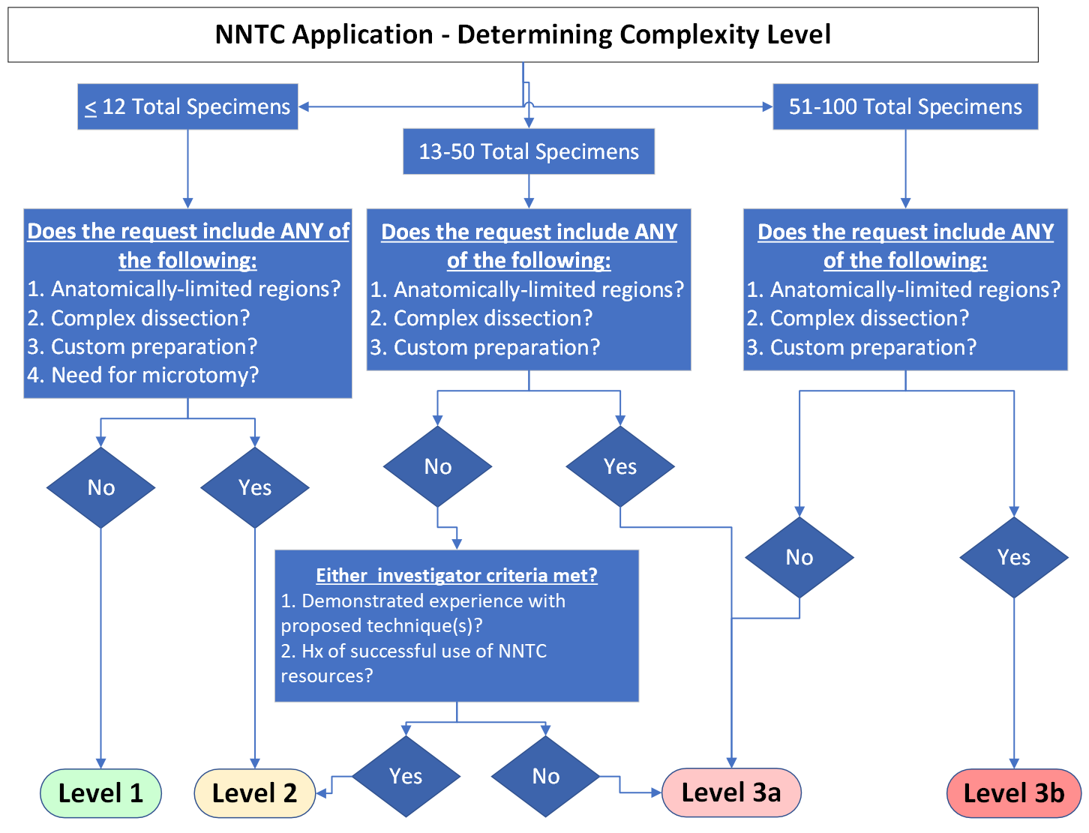
Determining Request Complexity Level
*Anatomically-limited regions include
hippocampus,
striatum,
nucleus accumbens,
basal ganglia,
choroid plexus,
brain stem nuclei
and any regions or samples that are not part of the required NNTC dissection or are not consistently available or are extremely difficult to find, collect and process from all participants.

Slide 6
Determining Request Complexity Level – Level 1 & 2
*Anatomically-limited regions include
hippocampus,
striatum,
nucleus accumbens,
basal ganglia,
choroid plexus,
brain stem nuclei
and any regions or samples that are not part of the required NNTC dissection or are not consistently available or are extremely difficult to find, collect and process from all participants.

Slide 7
Determining Request Complexity Level – Level 2 & 3a
*Anatomically-limited regions include
hippocampus,
striatum,
nucleus accumbens,
basal ganglia,
choroid plexus,
brain stem nuclei
and any regions or samples that are not part of the required NNTC dissection or are not consistently available or are extremely difficult to find, collect and process from all participants.

Slide 8
Determining Request Complexity Level – Level 3a & 3b
*Anatomically-limited regions include
hippocampus,
striatum,
nucleus accumbens,
basal ganglia,
Brain stem nuclei,
choroid plexus,
brain stem nuclei
and any regions or samples that are not part of the required NNTC dissection or are not consistently available or are extremely difficult to find, collect and process from all participants.

Slide 9
Emphasizing Benefits of Level 1 Complexity
Key Advantages of Level 1 Requests:
  Streamlined Review: Level 1 requests undergo the fastest review cycle, with a commitment to completing the review process within no more than 15 business days following submission of an application. This expedited pathway significantly reduces wait times, facilitating quicker project initiation.
  Swift Fulfillment: Following formal approval, shipments for Level 1 requests will be completed within 25 business days. This efficiency ensures that researchers receive their requested specimens promptly, enabling a seamless transition to the analytical phase of their projects.

Slide 10
Encouraging a Strategic Request Approach
NNTC will encourage requestors to start with smaller scale requests to leverage benefits of Level 1 timelines (e.g., pilot studies, proof-of-concept). This approach allows for:
  Rapid Validation: Quickly validate hypotheses or methodologies, providing a solid foundation for larger-scale investigations.
  Optimized Resource Use: Ensure the feasibility and efficiency of research approaches, optimizing the use of NNTC resources and setting a precedent for future project expansions.
  Informed Scaling: Gather crucial initial data that can guide the scaling up of research, ensuring that subsequent phases are built on robust, preliminary findings.

Slide 11
Request Process Overview - Application
Note: Applications requiring only minor modifications may not need to return to the beginning of initial screening.

Slide 12
Application Review: Overview of Steps
Application Review Steps:
  Initial Screening
    DCC review
    Site PI review
    Assignment of Request Complexity Level
  Formal Review
    Site PI review
  NIH Review (if needed)
    NIH review

Slide 13
Summary of Review Steps – Initial Screening
Application Review
  Initial Screening
    DCC: Performs the first review of a submitted application. Focus is on:
      Application completeness, including all required documentation
      Basic feasibility review of the application (requested tissue amounts, number of donors, etc.)
    Site PIs: After DCC completes review, the Site PIs review. Focus is on:
      Basic scientific review
      Preliminary inventory check for tissue availability to determine any potential issues with the feasibility of fulfillment
    DCC: Assignment of Request Complexity Level
      After the DCC and Site PIs complete initial screening review, the DCC assigns the application a Request Complexity Level.

Slide 14
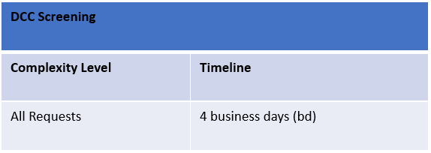
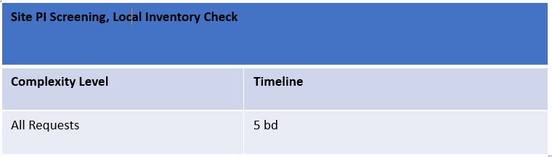
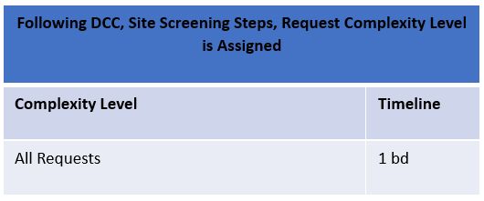
Initial Screening Timelines

Slide 15
Summary of Review Steps – Formal Review
Application Review
  Formal Review
    Timelines for Formal Review are driven by Request Complexity Level
    Site PI review: Perform a complete scientific review of the application to arrive at either approval/denial decision, or to request modifications to the application.

Slide 16
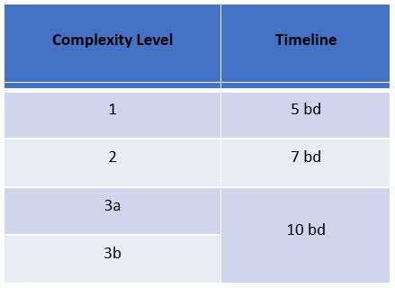
Formal Review Timelines
Application Review continues with Formal Review after Request Complexity Level formally assigned.
Duration of formal review is driven by the complexity level of the request.

Slide 17
Summary of Review Steps – NIH Review
Application Review
  NIH Review (only implemented for denied applications)
    Timeline for NIH review is not driven by Request Complexity Level
    NIH review ONLY occurs if an application is denied during Formal Review
    NIH will perform an additional review of denied applications to determine if there is any way that the consortium might be able to accommodate the request.
      If NIH review determines that an application should be approved, this decision will override the denial decision from Formal Review.

Slide 18
NIH Review
Only occurs when an application is rejected by the Executive Committee.
Note: NIH review duration does not depend on Request Complexity Level.
Complexity Level | Timeline
All Requests | 5 bd

Slide 19
Request Fulfillment Timelines
Request fulfillment timelines begin as soon as an application is approved.
Complexity Level | Timeline
1 | 25 bd
2 | 40 bd
3a | 60 bd
3b | 80 bd

Slide 20
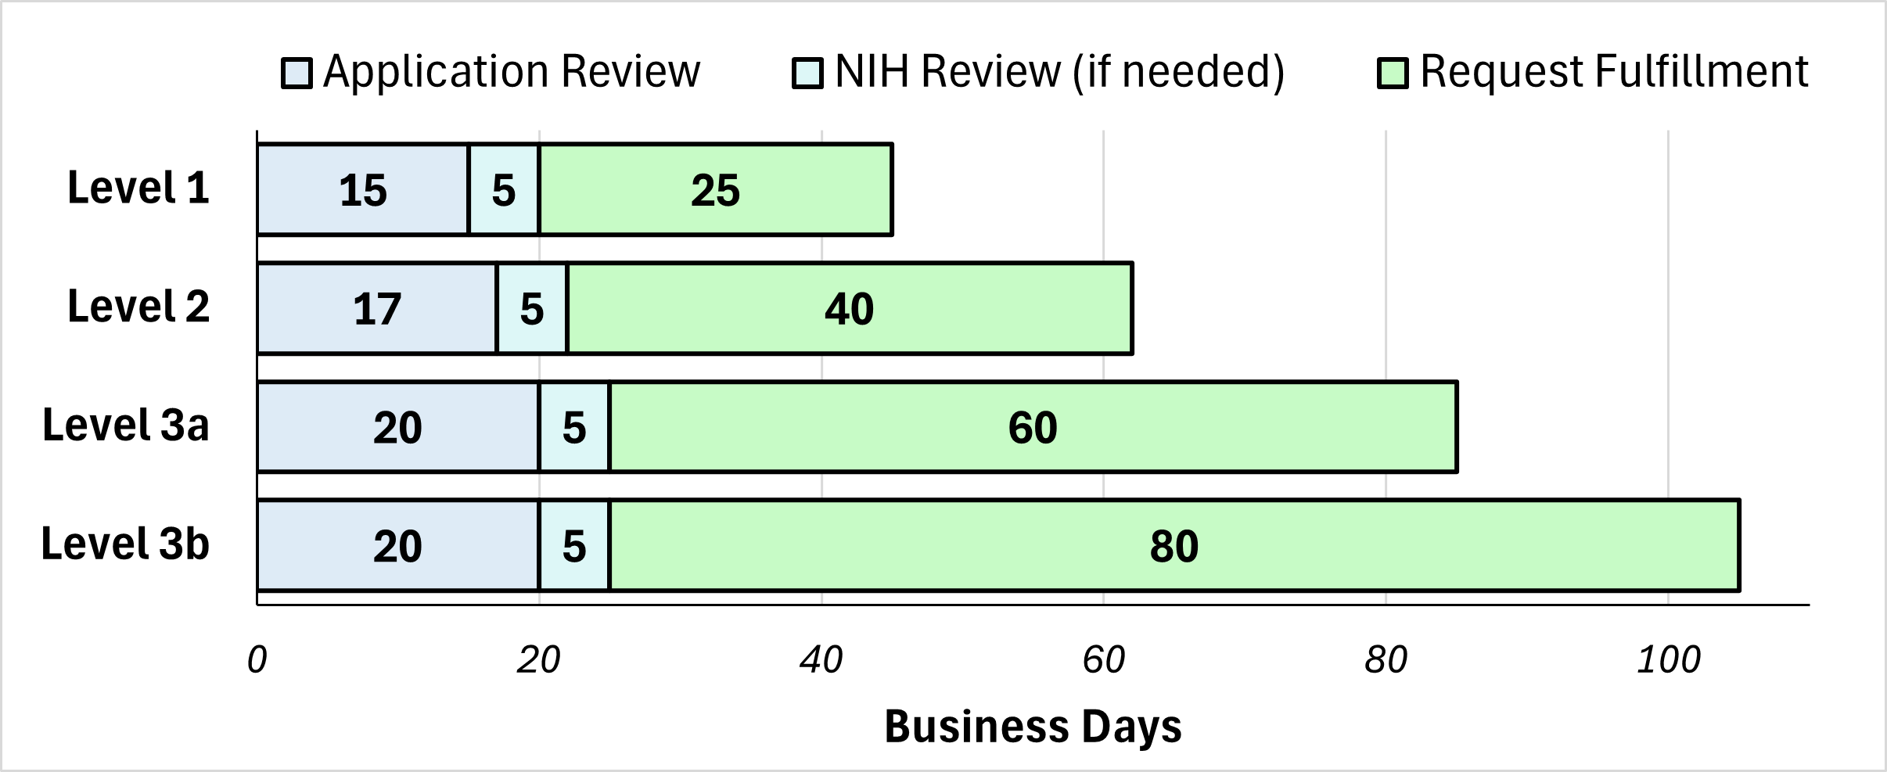
Overall Timelines, by Request Complexity Levels
Complexity Level | Application Review | NIH Review (if needed) | Request Fulfillment | Grand Total (includes NIH review)
1 | 15 bd | 5 bd | 25 bd | 45 bd
2 | 17 bd | 5 bd | 40 bd | 62 bd
3a | 20 bd | 5 bd | 60 bd | 85 bd
3b | 20 bd | 5 bd | 80 bd | 105 bd

Slide 21
Requestor Training, Supporting Documentation
NNTC Request Processing and Fulfillment Guidelines
  Details the process outlined in this presentation.
  Intended as the comprehensive resource for any requestor to describe the application management and review workflow under the new Rubric.
Request Processing Checklist
  Completed, signed copy required for all applications
  Intended to walk investigators through every step of the application process
  Requiring a signed copy helps enforce our expectation that requestors review and understand our expectations and needs for an application.
[to be developed] Video Training Modules
  Intended to bolster the training offered by NNTC to support requestor education and to improve the quality of applications submitted to the NNTC.

